Slide 1
Group 6:Eskom Challenge
Digital Submission and Judging Platform

Slide 2
01
Contents
Team
Get to know the faces behind the solution and their contributions.
02
Problem
The what, who and why?.
03
The Proposed Solution
Intended users, the technology used and the value to the community.
04
Conclusion
Challenges experienced and future improvements.

Slide 3
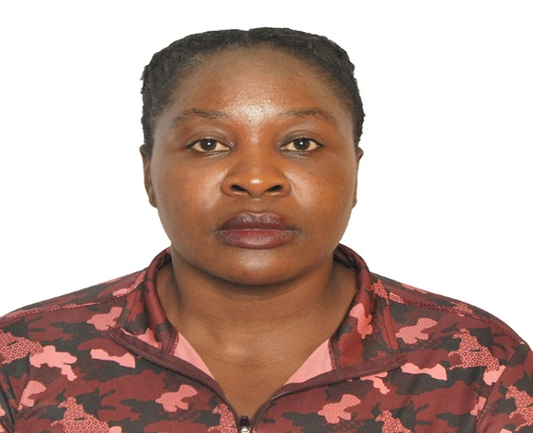
Meet the Team
1st
2nd
3rd
4th
5th
Priviledge Mabiza:
Team Lead
Lumo Godloza: Main Developer
Namhla Lingela: Researcher and coordinator
Asisipho Mkencele: Designer and Tester
Lifelong learner with experience in website development, project management and user-centered designs
You can simply impress your audience and add a unique zing and appeal to your Presentations. Easy to change colors, photos and Text.
You can simply impress your audience and add a unique zing and appeal to your Presentations. Easy to change colors, photos and Text.
You can simply impress your audience and add a unique zing and appeal to your Presentations. Easy to change colors, photos and Text.

Slide 4
Contributions
Priviledge
Lumko
Namhla
Asisipho
Leadership, Communication, Time management, decision-making, Testing, Quality assurance
Programming, Database design, Prototyping, System integration, Debugging
Research, Documentation, Business Analysis, Testing, Development and quality assurance
Creativity, User-centred design, Prototyping, Attention to detail, Usability and User experience
01
02
03
04

Slide 5
What is the Problem?
Poor user experience
Eskom Expo for Young Scientist
Learners, Judges and administrators often express frustration with legacy system.
Provides learners with an opportunity to showcase their scientific research.
Inefficient legacy system
Lacks Transparency
The submission, review and judging processes require a more efficient, secure and user-friendly digital solution.
As is processes lacks transparency as there is no proper documentation and filing.
Accessibility Issues
Heavy administrative workload
Learners are failing to showcase their research..
Prone to errors as there is no proper management of legacy system.

Slide 6

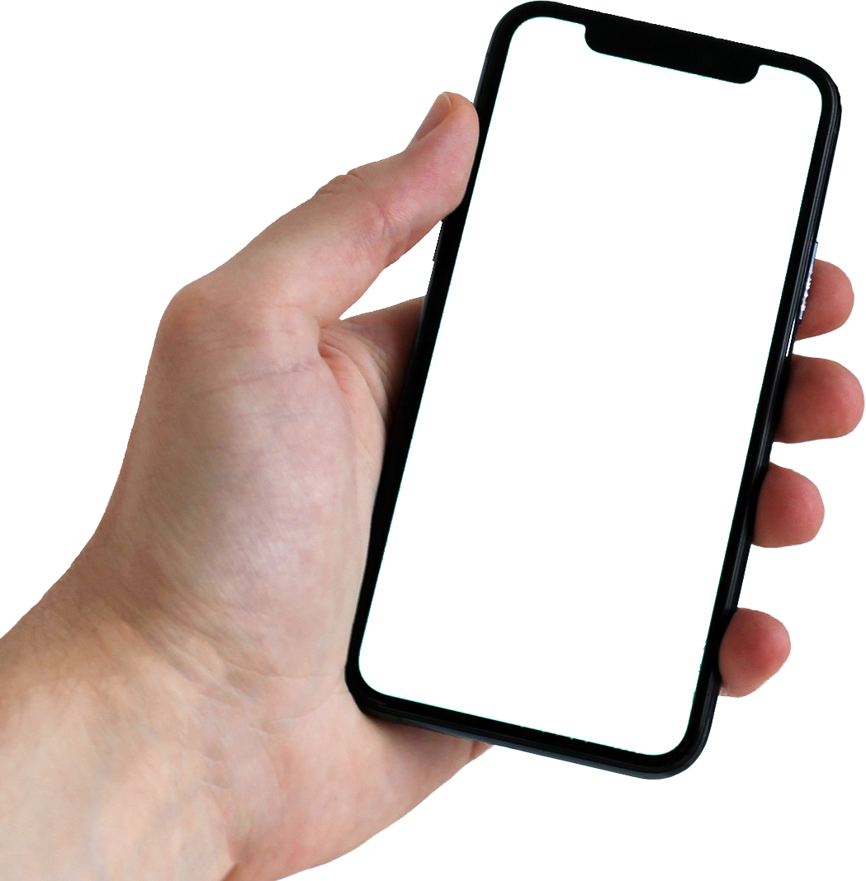
Who is affected?
Learners
Sometimes find it hard to register and submit their research for feedback.
Judges
Sometimes fail to evaluate projects and provide feedback
Administrators
Often fail to manage users, projects, judges and reporting.
Teachers
Fail to monitor and track learner submissions

Slide 7
Why digital Transformation?
The proposed system is a secure cloud-based web application that digitises the complete Eskom Expo project management process.
Enable learner registration
For Learners
Digital submission of research projects
Real time communication with administrators
Receiving feedback
For Judges
Review submissions online.
Score projects using a standard rubric and provide feedback
Automated management of users and submissions
For Administrators
Allocating judges and generating reports

Slide 8
Proposed system combines software engineering, database design, web development, AI, security and user experience .
Digital Submission and Judging Platform for Eskom

Slide 9
Value of proposed system
Performance.
Support thousands of concurrent users during peak submissions.
Scalability & Maintainability
A
Cloud native architecture capable of handling national participation growth. Documented codebase
Availability & Accessibility
B
99.9% uptime with redundancy and automated backups.. Accessible to users with disabilities
Security & Reliability
C
Encryption in transit and at rest, RBAC, audit trails and secure authentication. Automatic backups and disaster recovery.
D
Usability
Responsive interface accessible on desktops, tablets and smartphones

Slide 10
Technology Stack
Frontend
You can simply impress your audience and add a unique zing and appeal to your Presentations.
Backend
You can simply impress your audience and add a unique zing and appeal to your Presentations.
Database
You can simply impress your audience and add a unique zing and appeal to your Presentations.
AI Services:
File Storage and Aunthentication
You can simply impress your audience and add a unique zing and appeal to your Presentations.
Reporting and Deployment
You can simply impress your audience and add a unique zing and appeal to your Presentations.

Slide 11
Module 1: Learner Portal
Secure registration and Login
Personal Dashboard with user Profile
Start new project, Save draft and continue later
Upload files and view submission status
View feedback and download certificates

Slide 12
Module 2: Judge Portal
Status
Years of Experience
Deadline
Research Interests
Availability
Occupation
Scientific field
Name
Qualifications
Institution

Slide 13
Module 3: Administrator Portal
05 Generate reports
04 Manage Categories & deadlines
03 Assign projects
02 Approve judges
01 Manage users

Slide 14
Module 4:Online Judging
Each assigned project gets judged with a digital rubric
Criterion could include, originality, Scientific Method, Research Quality, Presentation, Impact etc.
67%
43%
78%
55%
90%
43%
Could be graded For Scientific Method.
90%
Could be for Impact.
Judge Feedback: Excellent use of AI models. Increase your sample size. Your Scientific Method needs more work and also work on your presentation skills. Overall, the research idea is novel, the research quality is commendable and the impact is excellent.

Slide 15
Module 5: Reporting and Analytics
A
C
South America
North America
Asia
Australia
B
D
A
B
C
D
Participation Statistics, Judge Workload, Submission Trends, Gender Distribution, Provincial Statistics etc.
Projects by Continent, Country or Province
Projects by Category, 35% Computer Science
22% Engineering
Export as PDF, Excel or CSV

Slide 16
Challenges Experienced
Limited Coding Experience
Limited Development time
Not all team members had extensive experience with web application development
The hackathon allowed limited time to design, develop, and prepare a working solution.
Matching team skills and coordination
Designing for Scale
The platform is intended for a national competition with many users, but a full-scale implementation was not feasible within the hackathon.
With multiple team members working simultaneously, integrating everyone's contributions efficiently was challenging

Slide 17
AI Features: Future Improvements
Similarity detection
Flag projects with highly similar reports for plagiarism review.
Check for missing sections, incorrect, formats or incomplete submissions before final upload
Documentation Validation
Match judges to projects using Natural language Processing on project abstracts and judge expertise.
Automatic Judge Recommendation
Forecast participation trends for planning purposes.
Predictive Analytics

Slide 18
End to end learner journey
Learner registers and submits project
Judge evaluates
Administrator approves and assigns judge
Learner views results

Slide 19
THANK YOU

